Slide 1

JPEG COMPRESSION and DECOMPRESSION
Andrei cadar Calin

Slide 2

About JOINT PHOTOGRAPHIC EXPerts group
JPEG together with PNG are the most used compression mechanism todays.
Advantages of JPEG over PNG are that it usually has a smaller file size and faster loading time, while PNG supports transparency and has a higher quality.
In this project I implemented the JPEG compression method, but the result is stored in a binary file, which does not follow the standard JPEG file metadata so it cannot be opened in an image viewer.
The input image must be a colored image with 3 channels on 8 bit color depth each.

Slide 3
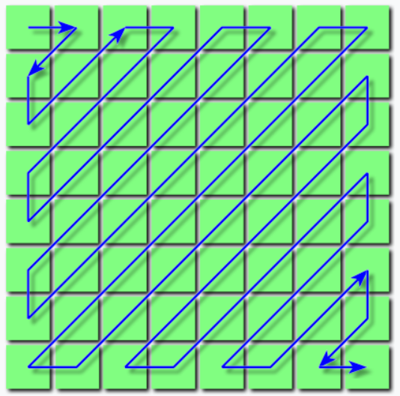
About project
We will define the following terms:
Compression ratio: size on disk of original image divided by size on disk of compressed binary file
DCT: discrete cosine transform
Block: matrix of 8x8
Quality: quantization matrix, not to be confused with compression ratio
Ychannel: Luminance channel from YCrCb color space
CrChannel and CbChannel: Red and Blue channels from YCrCb color space
ZigZag: Iterate through elements of a block in a zig-zag manner like bellow

Slide 4
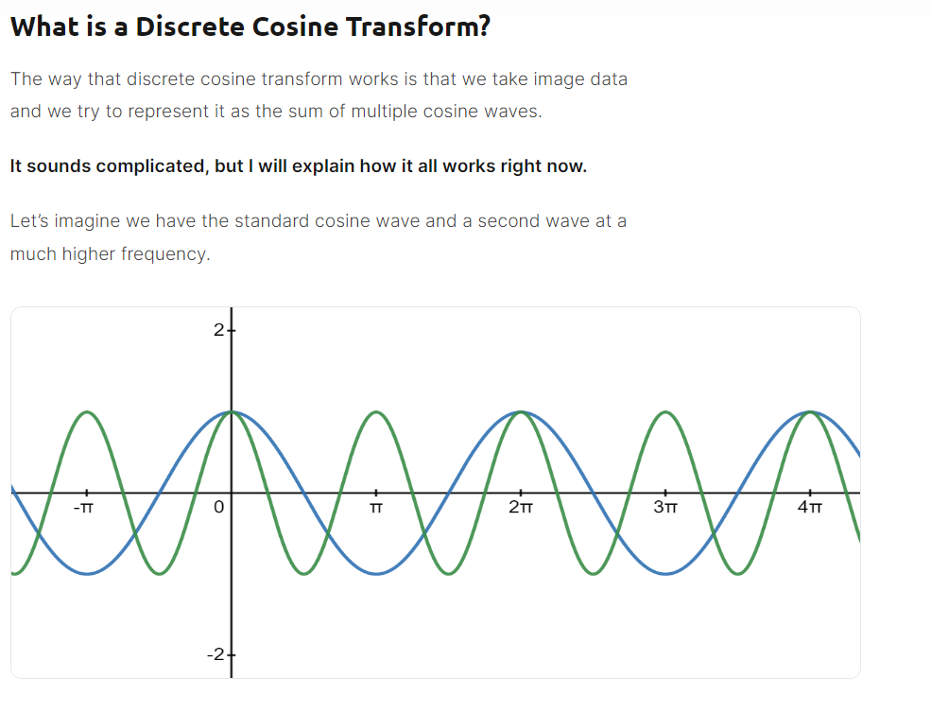
My work and research
For this project I had two trustworthy sources that had almost the same information but in some places they complemented each other.
JPEG Wikipedia https://en.wikipedia.org/wiki/JPEG
The Ultimate Guide to JPEG Including JPEG Compression & Encoding https://www.thewebmaster.com/jpeg-definitive-guide/
On these websites every step was explained in detail with examples.

Slide 5
The algorithm
The JPEG compression algorithm has the following steps:
Downsampling
Padding and splitting in 8x8 blocks
Map block to [-128, 127] range
Apply DCT on block
Compress block by quantization matrix
Zig Zag
Run-length encoding

Slide 6
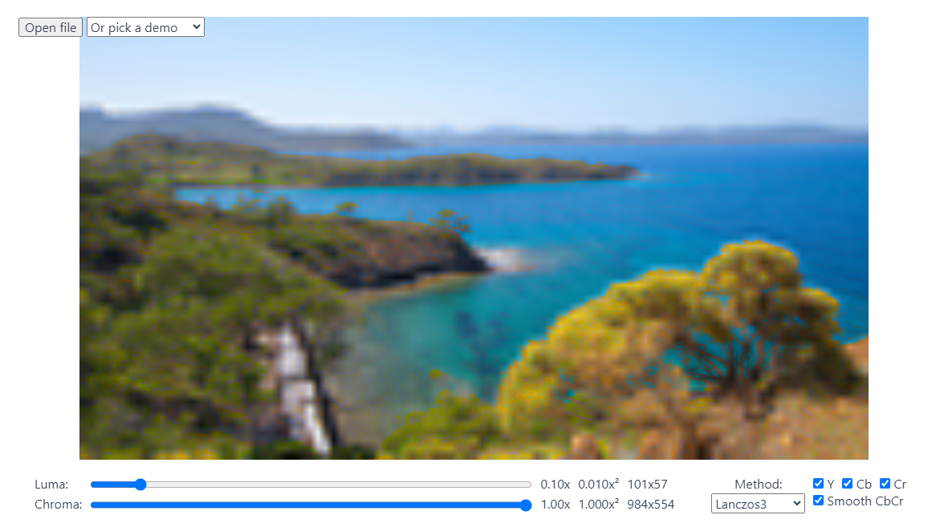
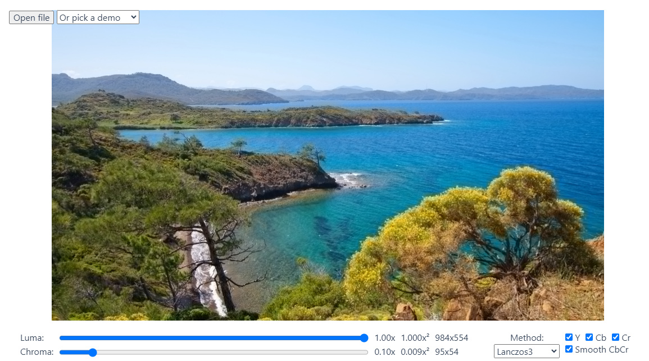
Downsampling
The JPEG algorithm takes advantage that the human eye is more sensitive to luminance rather than coloring. This can be very nicely seen on https://www.thewebmaster.com/jpeg-definitive-guide/.
We can see that dividing Chroma quality by 10 times produces a far better result than reducing Luma quality. Not to mention that we have 2 chroma channels and only one luminance channel.

Slide 7
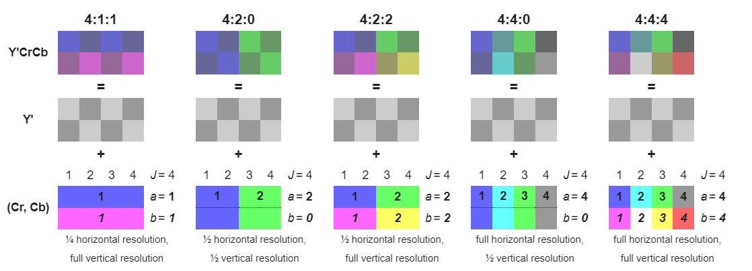
Downsampling
There are various ways of downsampeling, I have chosen 4:2:0 because it is symmetric and has a high compression ratio, ¼. I store the average value of the 4 pixels for each chroma channel.

Slide 8
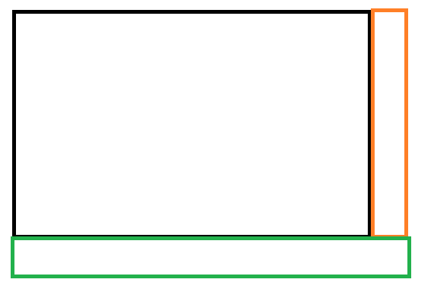
Padding and splitting in 8x8 blocks
The image needs to be padded to have rows and column multiple of 8 to be easy to split it into 8x8 blocks to be compressed. I have chosen to pad with the last column and row multiple times, the bottom right corner is padded using the last row after it was extended.

Slide 9
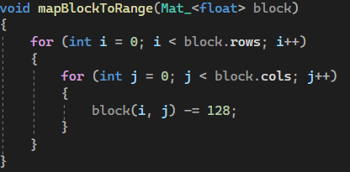
Map block to [-128, 127] range
Before computing the DCT the block’s values must be shifted from a positive range to one centered at zero. In this case every element must be subtracted by 128.

Slide 10
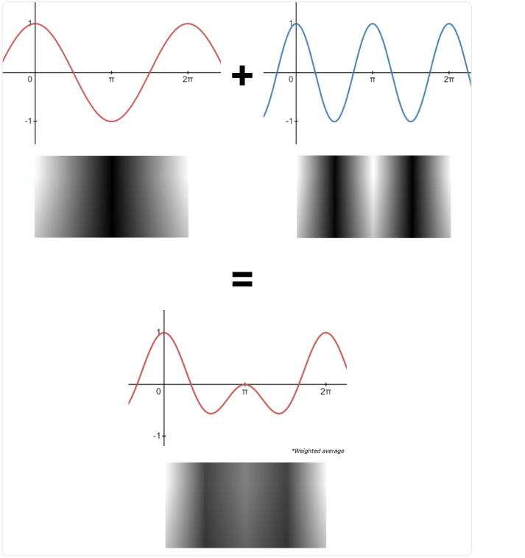
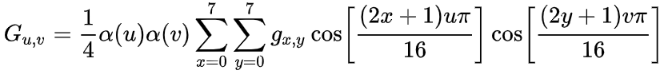
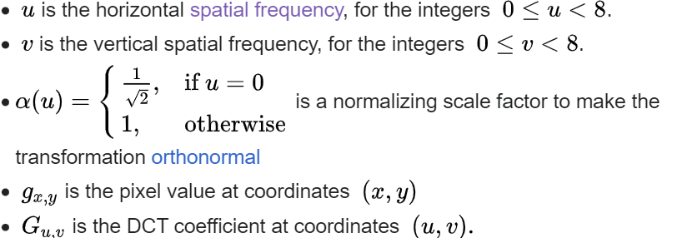
Apply DCT on block
We can use 64 cosine waves like this to produce every pixel of a 8x8 block.
We apply the following DCT formula for every pixel.
We can see that the term in front is a constant that can be calculated before every 8x8 traversal, increasing performance.

Slide 11
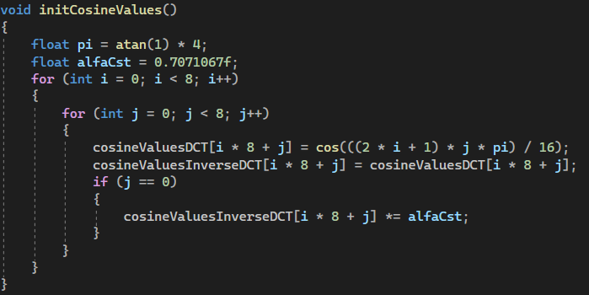
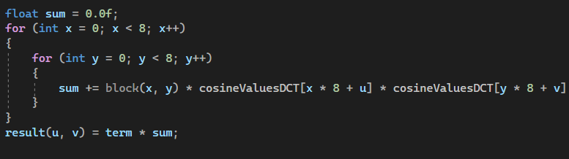
Apply DCT on block
We also observe that the argument of cosine takes at most 64 distinct values.
0<=x<8, 0<=u<8. This is why we can calculate this values at the beginning only once and take them from a table when needed. This offers a great performance improvement because otherwise we would calculate 2*h^2*w^2 cos operations which are a lot and also computational intensive.

Slide 12
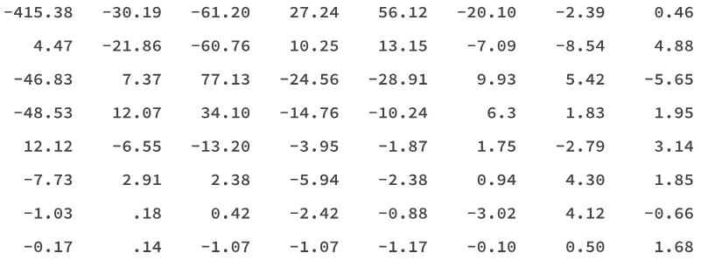
Apply DCT on Block
The result of the DCT for every pixel will be a matrix with float values, for example:
DC coefficient - This is the top left-hand corner DCT coefficient, otherwise known as the constant component. This defines the basic hue for the entire 8x8 pixel block.
AC coefficients - These are the remaining 63 DCT coefficients, otherwise known as the alternating components.

Slide 13
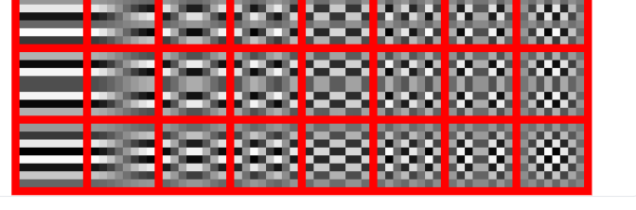
Compress block by quantization matrix
Quantization relies on the principle that humans are better at seeing small differences in brightness over a larger area but not so good at distinguishing high-frequency brightness variations.
You can see that the coefficients in the bottom right of the frequency domain matrix have a much smaller influence on the final image than the low-frequency coefficients in the top left.
The quantization process uses this fact to significantly reduce the amount of information in the high-frequency components. It does this by dividing the DCT coefficient by the quantization matrix.
High frequencies in bottom right of the image.

Slide 14
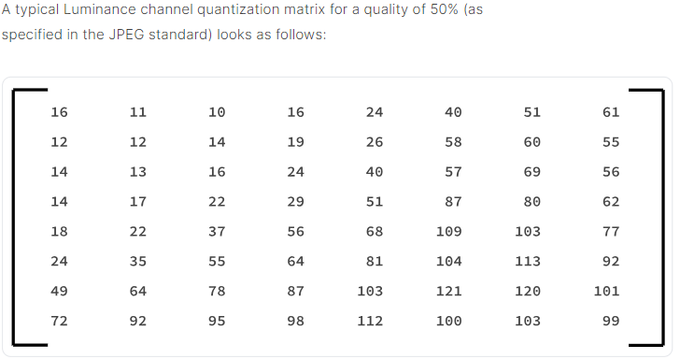
Quantization Matrix
Based on the numbers in the quantization matrix a quality factor is achieved. Usually for luminance 50% quality is used, but as discussed previously for chroma lower qualities can be used without impacting visuals.
Each value in the DCT block is divided by a integer from the quantization matrix and rounded to the nearest integer. The final goal is to have as many identical values as possible so higher the number in the quantization matrix the higher the probability. Why?
If we divide a number by 5 and round to the nearest integer, 1 and 2 will be rounded to 0 and 3,4 and 5 to 1. But if we choose 20, all the numbers from 0 to 9 will be rounded to 0. If we choose 100 we make buckets of 50.
We can see we have higher numbers in the bottom right, where the
high frequency cosine waves have a small influence on the result.
we can eliminate that information without visible losses in quality
by placing all of them in the same bucket.

Slide 15
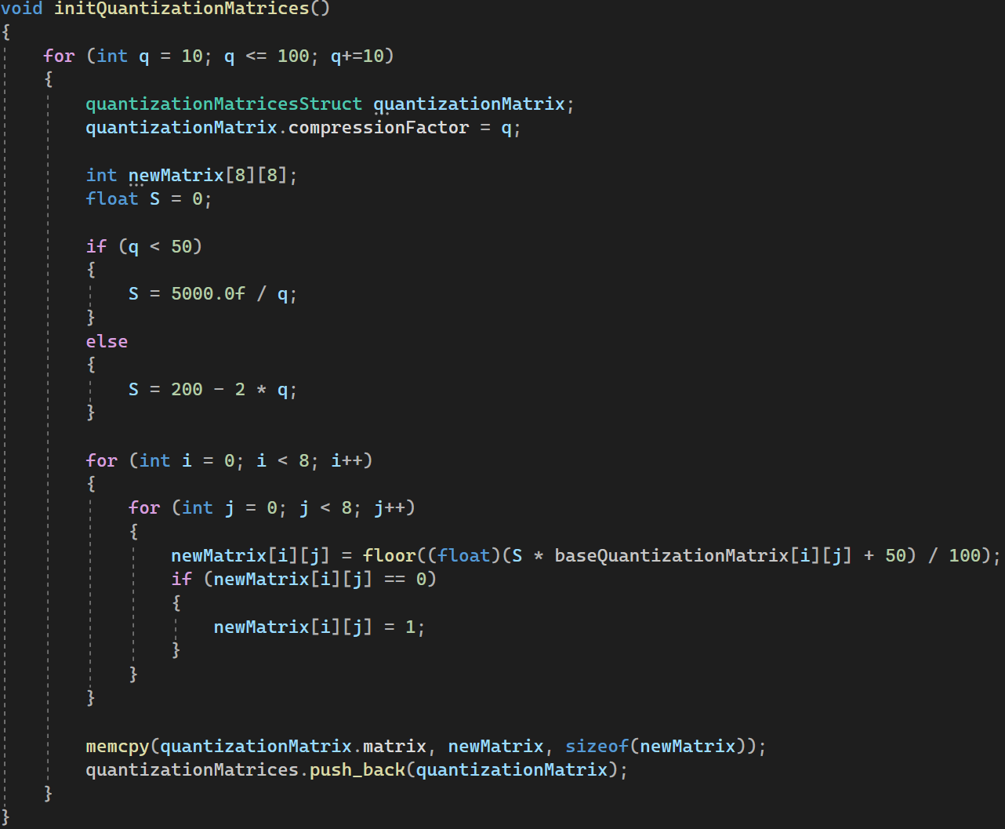
Quantization matrix
There is an algorithm to compute quantization matrices for any quality between 0 and 100 using the 50 quality matrix as a standard.
We must be careful to substitute 0 values with 1 to avoid division by 0.
With the current implementation the maximum allowed quality is 70%, because after that the values to be written on the disk do not fit a one-byte representation.

Slide 16
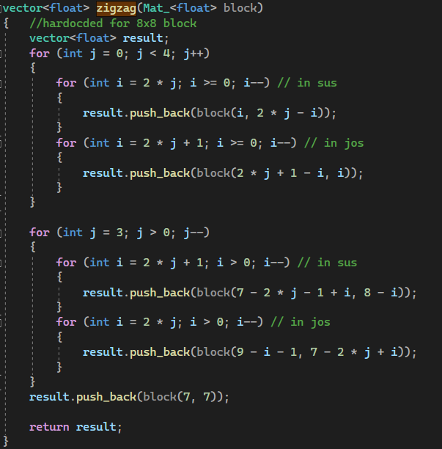
Zig Zag
After the compression a lot of values which are equal, mostly 0, are concentrated in the bottom right corner.
This is why after applying a zig zag iteration like this one the similar values will come one after the other.
In this way, we will have some space when performing run-length encoding.

Slide 17
Run-length encoding
Run length encoding saves a lot of space when a lot of equal values are one after the other. For 5 consecutive zeroes, we would write 2 bytes, a 5 and 0, so we saved 3 bytes. In this way whenever there are at least three consecutive values we save at least one byte.
All the pairs (Number Of Apparitions; Value) are written to the binary file. To know when we finished to write a block we write the pair(0,0) because we can never have 0 number of apparitions. (one zero would be enough to write but complicates the reading from the binary file).

Slide 18
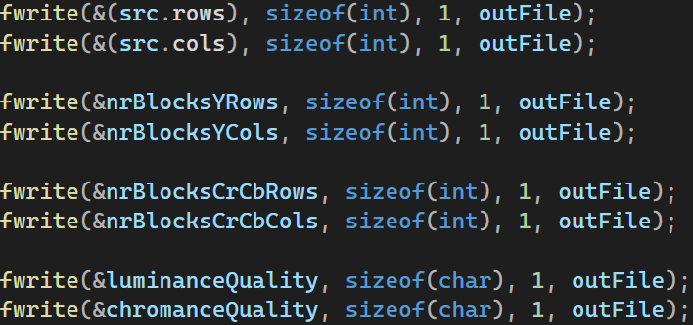
Writing to the binary File
The output file is a custom binary file which does not respect the JFIF format.
In the beginning I have chosen to write the original size of the image, number of luminance blocks per rows and columns, number of chroma blocks per rows and columns per channel and also the quality factor for luminance and for chroma.

Slide 19
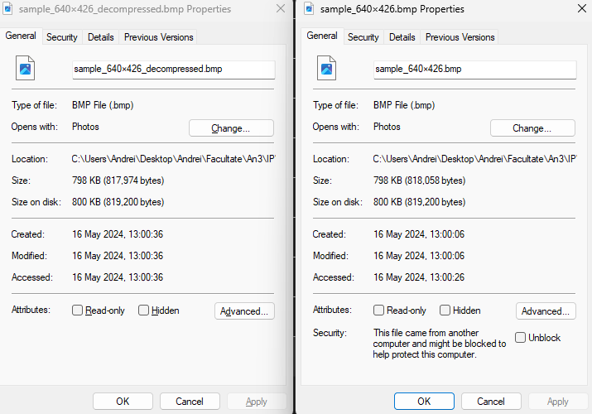
Writing to the binary File
After this metadata is written, pairs of (Aparitions, Value) are written for each block and at the end of the block pair 0,0 is written. Firstly all luminance blocks are written, then chroma red channel and after that the chroma blue channel.
Why do we need the original size written? Because when padding we add rows and columns in the image data. At the end of the decompression, we can use the original size to cut the decompressed image to its true size.
We can see that the sizes on disk are exactly the same even if the image was padded. (426 is not multiple of 8).

Slide 20
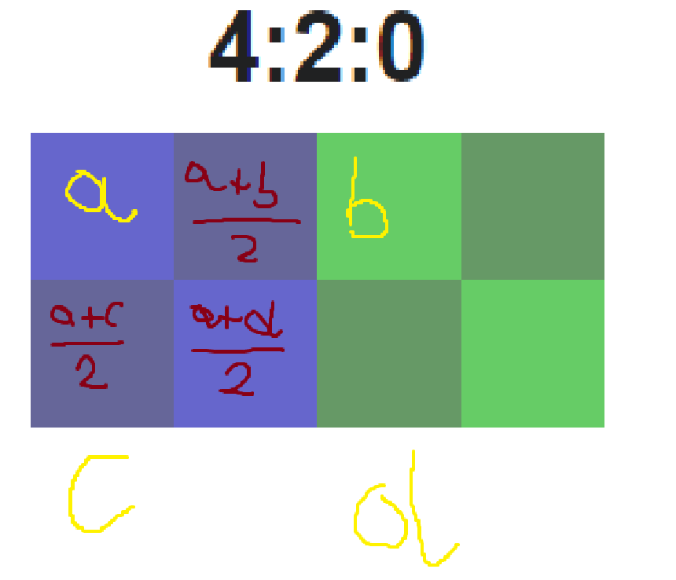
DECOMPRESSION
For decompression all the inverse operations are performed in reverse order.
One thing to note is when doing the upsampling I perform linear interpolation when expanding the values.
a, b, c, d are known and each value is expanded to 4.

Slide 21
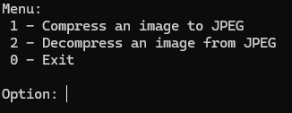
The program
The program was written in C# using the opencv2 library version 4.9.
The thread implementation used is the one from std library but imported <thread> to get the number of threads.
The user can import the whole project and find the executable in the following path: /JPEG(D)Compression/x64/Release/.
The user by using Visual Studio can build a version for x86 also or even make a static linked executable so it can be runed stand-alone from any location on the computer.
When executing the program the user is prompted a menu to select an action.

Slide 22
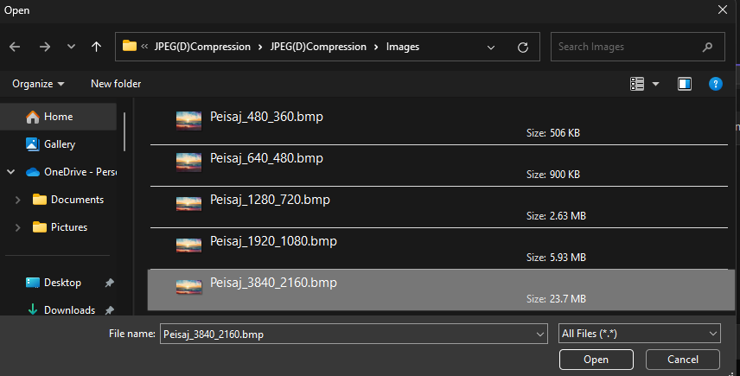
The program
After selecting either option the user is prompted with an open file dialog.
After selecting a file, the program runs and a loading bar is displayed. It changes to 10%, 40%, 70% and 100%. At the end the time of execution is displayed in seconds.

Slide 23
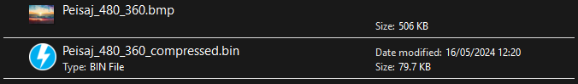
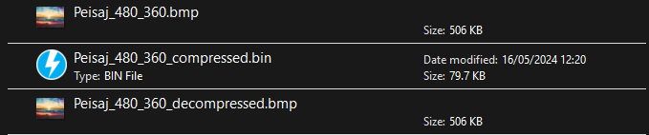
The program
After compressing an image named “image.bmp”, the compressed binary file is saved in the same folder named “image_compressed.bin”.
After decompressing a binary file named “image_compressed.bmp”, the decompressed image file is saved in the same folder named “image_decompressed.bmp” and displayed to the screen.

Slide 24
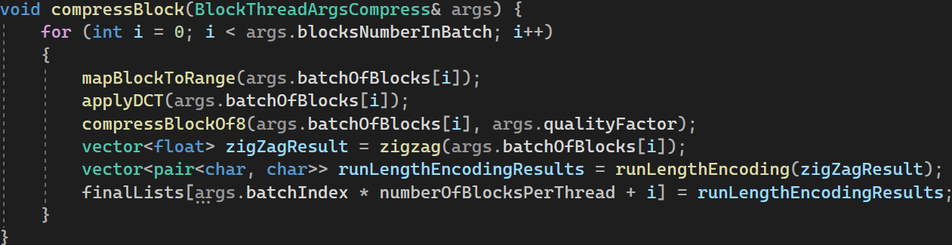
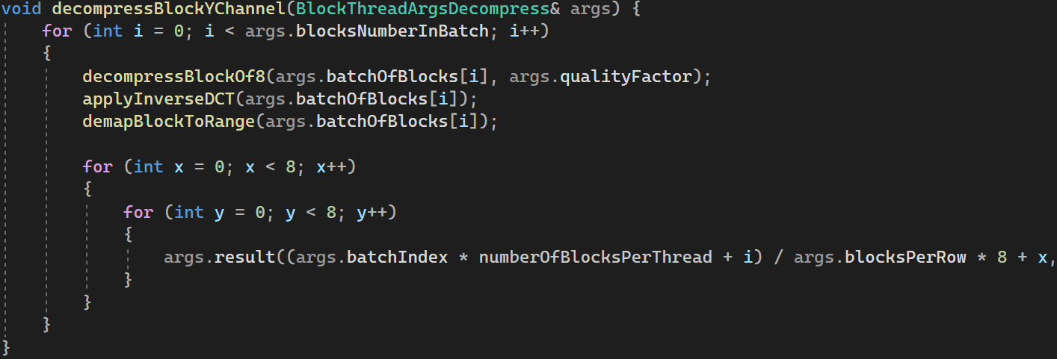
Structure of project
The project is very symmetric regarding compression and decompression.
We can see that the reverse of the main operations are done in reverse order in the decompression operation.

Slide 25
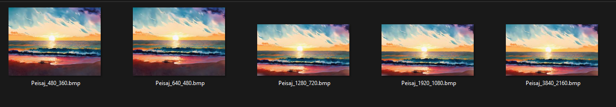
Testing and results
To test my project I have chosen a set of images which represent the same photo but at different sizes, from 360x480 to 2160x3840.

Slide 26
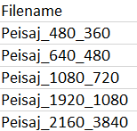
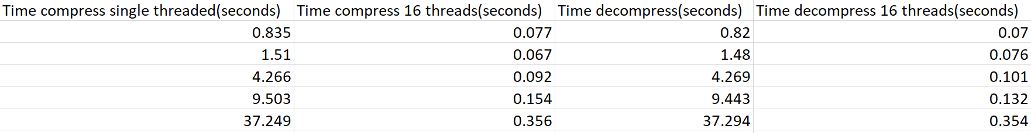
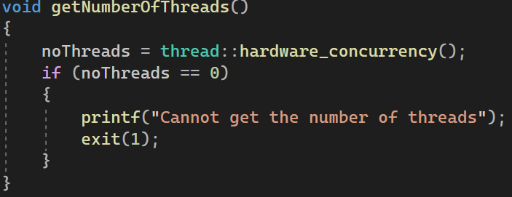
Performance improvements
To achieve maximum performance with the program I implemented it using multithreading.
With 16 threads I achieved from 20 to 100 fold increase in performance, depending on the file size. (code also may have been changed from single threaded to multithreaded)
The number of threads is taken from the system information so it does not need to be changed by the user.
The program splits the number of blocks to the number of threads to find how many blocks will each thread process, called a batch of blocks. The remaining blocks (from 0 to maximum (number of threads)) are processed in single threaded mode.
One improvement to be made here is to feed all the blocks from all the channels to the batch divider at once. Now we divide the blocks in batches after each channel and reset.

Slide 27
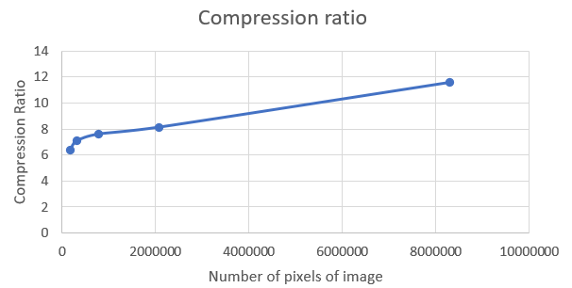
Testing and results
I ran compression and decompression for every image and stored the results in an excel.
These results are obtained using a 50% quality quantization matrix for both luminance and chroma.
We can see that the compression ratio
increases as the file size increases.

Slide 28
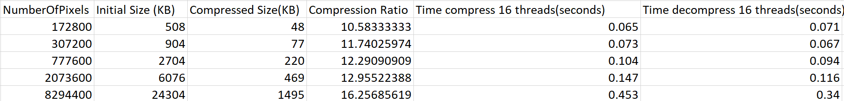
Testing and results
The lowest quality to still have a decent image was 20% for luminance and 10% for chromance.
For 4K images the compression ratio was 16.25
We can see that quality of compression does not influence the execution time.

Slide 29
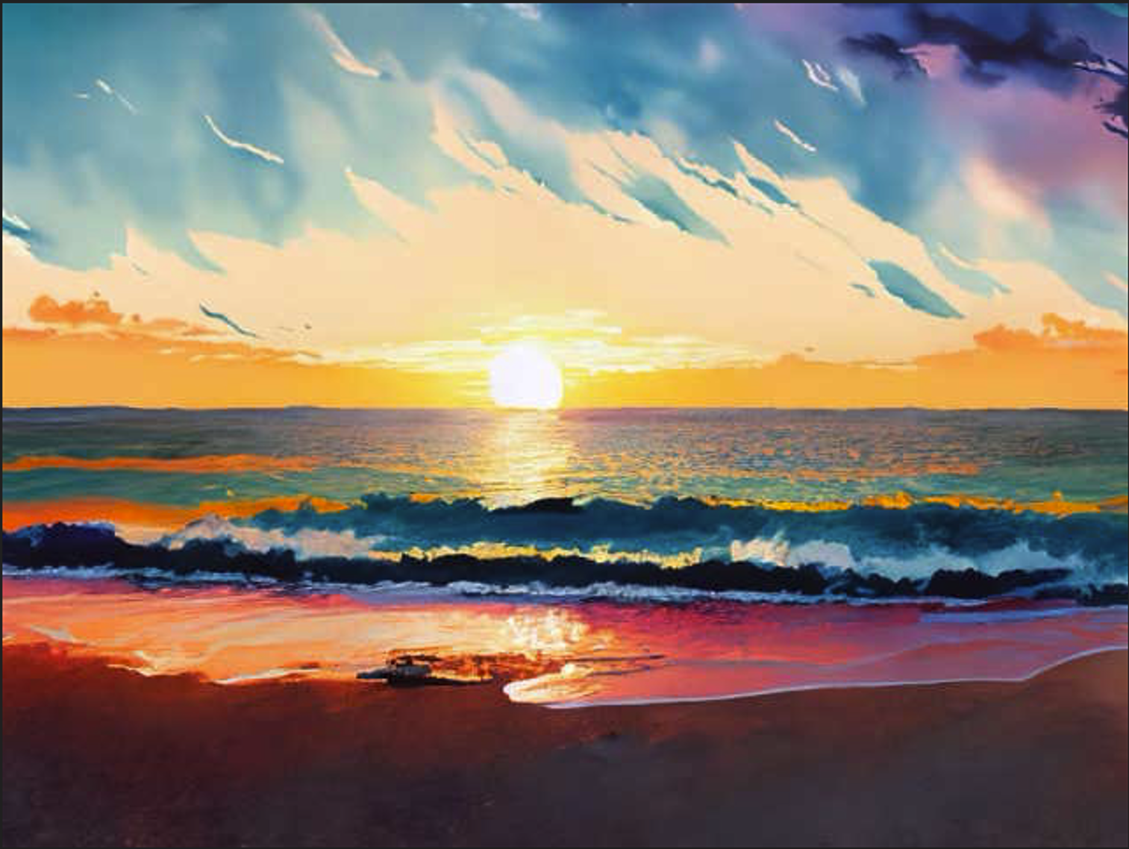
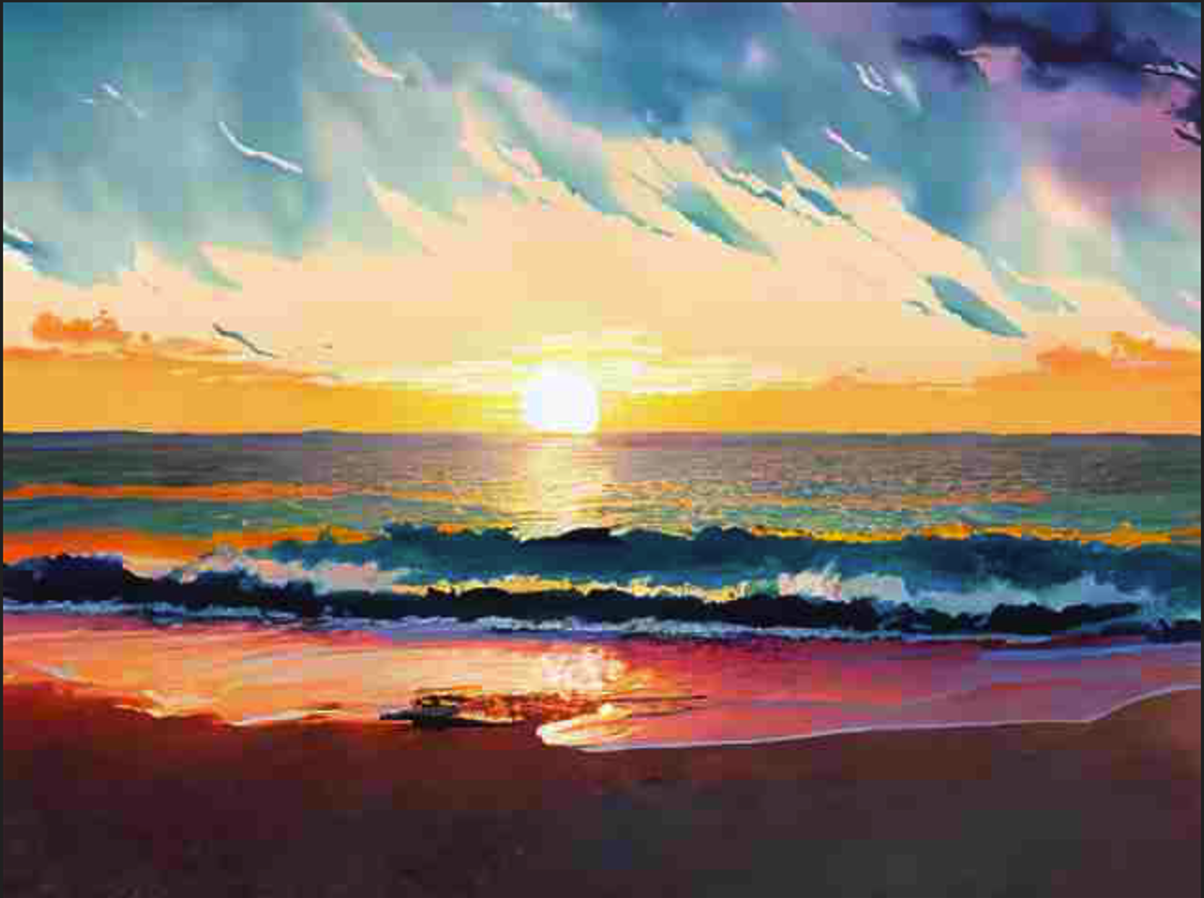
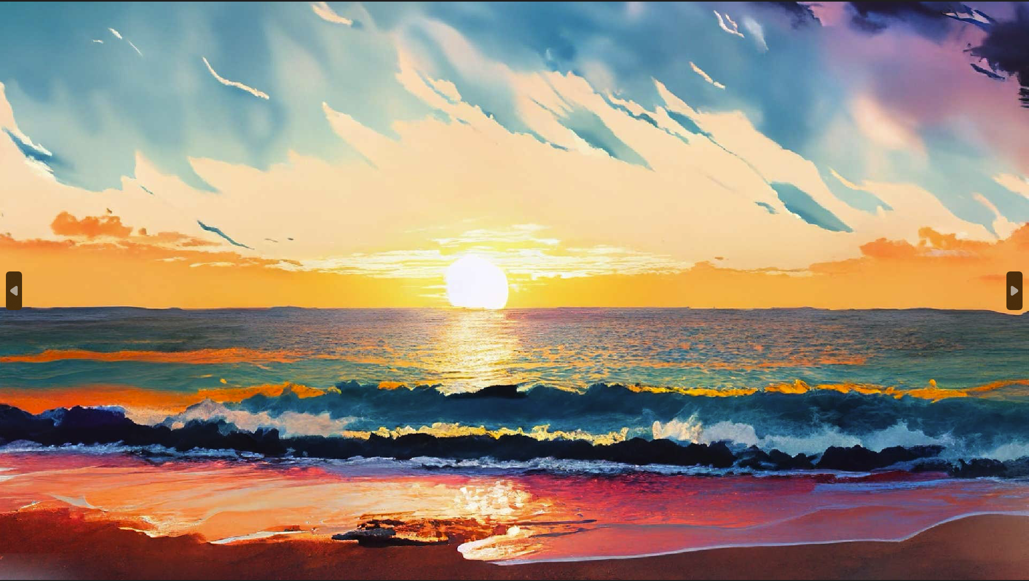

Testing and results
At this quality we can see some artifacts, especially in small picture sizes.
480x640
50%, 50% 20%, 10%
1080x1920

Slide 30
References
https://en.wikipedia.org/wiki/JPEG
https://www.thewebmaster.com/jpeg-definitive-guide/
https://stackoverflow.com/questions/29215879/how-can-i-generalize-the-quantization-matrix-in-jpeg-compression

Slide 31

Thank You
Andrei Cadar Calin
cadarandrei2370@yahoo.com

